Slide 1
Significant Digits

Slide 2

What are significant digits?
The significant digits in a measurement consist of all the digits known with certainty plus one final digit, which is uncertain or is estimated.

Slide 3
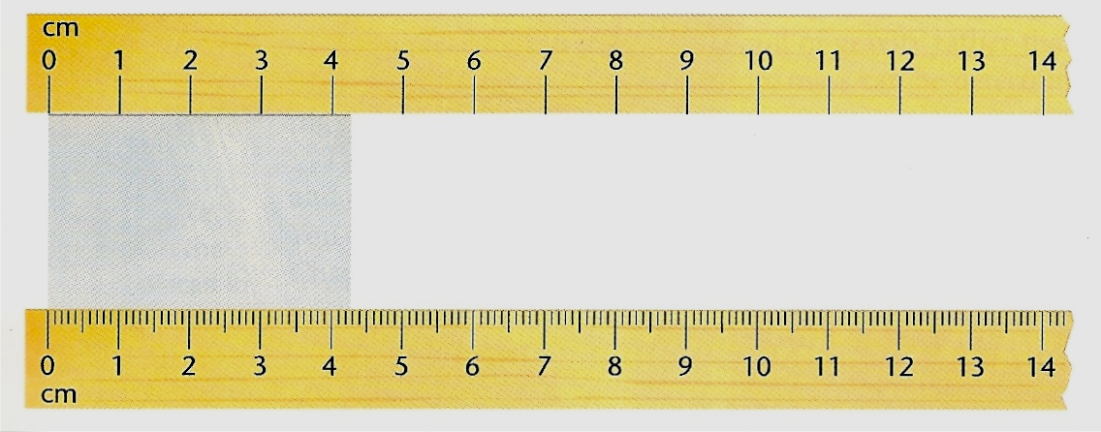
For example: Study the diagram below.
Using the ruler at the top of the diagram, what is the length of the darker rectangle found in between the two rulers?
Answer: The length is between 4 and 5 cm. The “4” is certain, but the distance past 4 cm will have to be estimated. A possible estimate might be 4.3. Both of these digits are significant. The first digit is certain and th second digit is uncertain because it is an estimate.

Slide 4
Using the ruler at the bottom of the diagram, what is the length of the darker rectangle found in between the two rulers?
Answer: The edge of the rectangle is between 4.2 cm and 4.3 cm. We are certain about the 4.2, but the next digit will have to be estimated. As possible estimation might be 4.27. All three digits would be significant. The first two digits are certain and the last digit is uncertain.

Slide 5
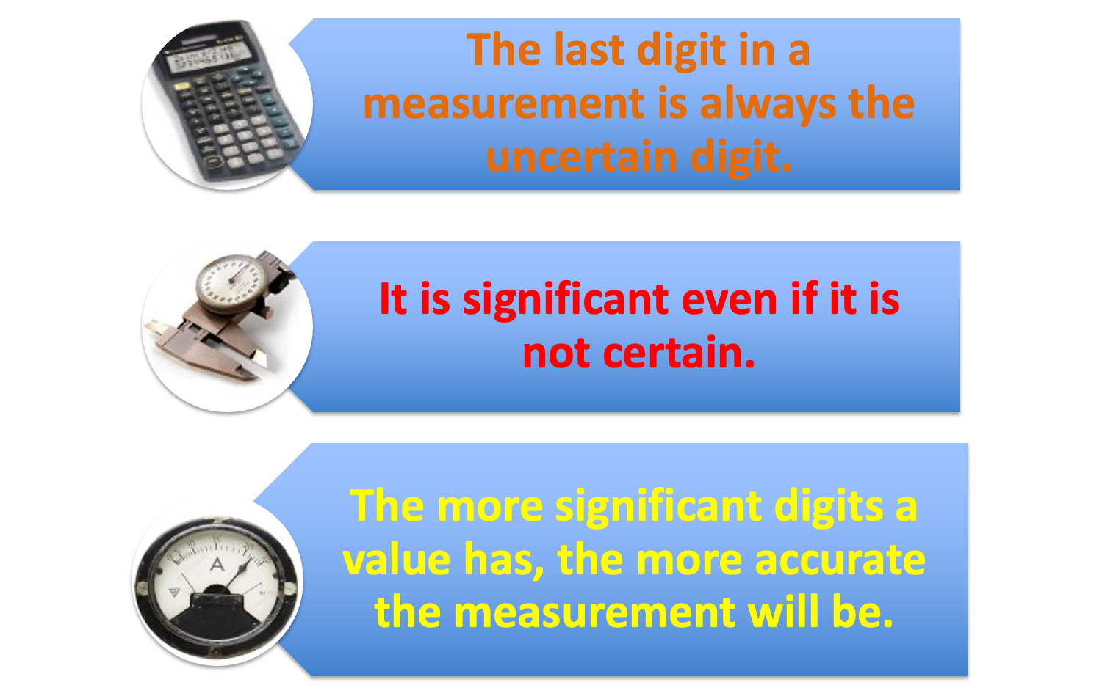
Please remember…

Slide 6
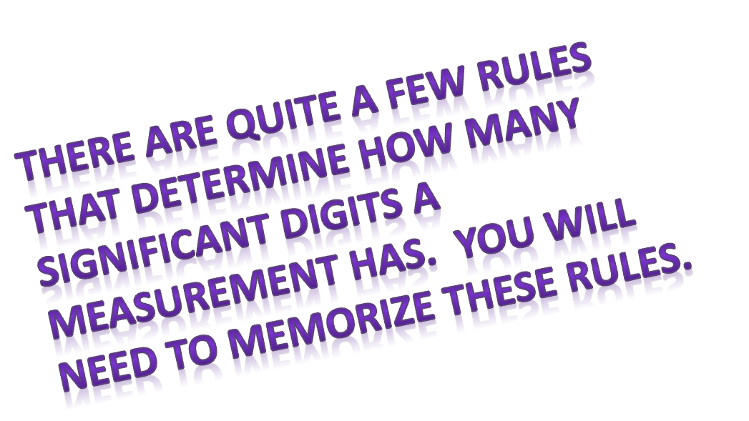
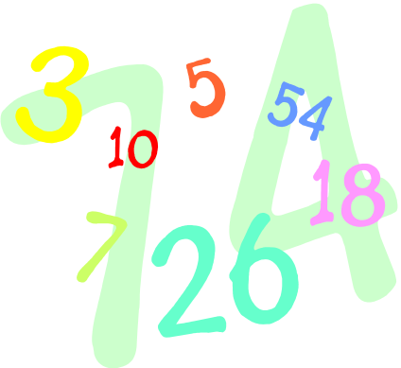


Slide 7
RULE: If a number contains no zeros, all of the digits are significant.
How many significant digits are in each of the following examples?
a) 438
b) 26.42
c) 1.7
d) .653
Answers:
3
4
2
3

Slide 8
RULE: All zeros between two non zero digits are significant.
How many significant digits are in each of the following examples?
a) 506
b) 10,052
c) 900.431
Answers:
3
5
6

Slide 9
RULE: Zeros to the right of a non zero digit a) If they are to the right of a nonzero number but not sandwiched between nonzero and decimal point, they are not significant.
Answers:
3
1
1
How many significant digits are in each of the following examples?
a) 4830
b) 60
c) 4,000

Slide 10
RULE: Zeros to the right of a non zero digit b) If these zeros are sandwiched between a nonzero number and a decimal point, they are significant.
How many significant digits are in each of the following examples?
a) 4830.
b) 60.
c) 4,000.
Answers:
4
2
4

Slide 11
RULE: All zeros to the left are not significant.
How many significant digits are in each of the following examples?
a) 0.06
b) 0.0047
c) 0.005
Answers:
1
2
1

Slide 12
RULE: All zeros to the right of a decimal point are significant (not at the left)
How many significant digits are in each of the following examples?
a) .870
b) 8.0
c) 16.40
d) 35.000
e) 1.60
Answers:
3
2
4
5
3

Slide 13
